Slide 1
Python for Data Analysis A Beginner's Tutorial INFX 574– Core Methods in Data Sciences
By
Muhammad Raza Khan
mraza@uw.edu
iSchool, University of Washington

Slide 2
Assumptions & Pre-Requisites
Experience in R
Knowledge of some Programming Languages (Python, Java, C++, etc)
Installation of Anaconda and Python

Slide 3
If you haven’t already, please install Anaconda
Anaconda is an open source computer program that includes various software for Python and R
Jupyter Notebook
Spyder
Rstudio
etc
Using the launch button on the interface usually works, but if not, you can also launch the Notebook by using Anaconda’s command prompt and typing in “jupyter notebook”

Slide 4
Why are we using Python in this course?
Uses packages that are highly useful in machine learning
Flexible (interpreted programming language)
R is used in data science as well, but just to keep things consistent, we highly encourage Python
Good skill to have too

Slide 5
References
Learning Python, 5th Edition by Mark Lutz
Programming Python, 4th Edition by Mark Lutz
Learning Python in 10 minutes
http://www.stavros.io/tutorials/python/

Slide 6
Python's Core Features
Variables
Variable Creation
Variable is created when we assign a value to it
Variables Types
Variables have no concept of types rather the objects stored in the variables have types
Variables are just references to the object
>>A=3
>>A='abc'
>>A=3.5

Slide 7
Python's Core Features
Blocks of Code
Level of indentation specifies the blocks of code
Indentation specifies start of the block
De- indentation specifies end of the block
Statements expecting indentation end in a colon (:)
Conditional Execution of Code : if , elif, else
>>marks=100
>>Aplus='A+'
>> if(marks>90):
print 'Grade is %s' %(Aplus)

Slide 8
Python Operators
Arithmetic Operators
+, -, *, /, ** ( Exponent) , // ( Floor Division)
Comparison Operators
<, >, <=, >=, ==, !=, <>(Similar to !=)
Bitwise Operators
&, |, ^, , ~, << , >>
Logical Operators
and, or , not
Membership Operators
in, not in

Slide 9
Python Data Types
Object Type | Examples
Numbers | 12,123.4, 3+4j
Strings | ‘hw’,”hw”
Lists | [1,2,3], [1,[2,3]]
Dictionaries | {‘a’:1,’b’:2}
Tuples | (1,2,3,4)

Slide 10
Class Activity 1: Simple Grade Calculator Program
If marks are greater than 90, grade is A, if marks are greater than 80 and less than 91 the grade is B, F otherwise
>> grade = 'F'
>> marks = int(raw_input('Enter your marks '))
>> if marks >90:
grade = 'A'
elif marks>80 and marks <91:
grade= 'B'
else:
grade='F'
>> print 'Marks = %d, Grade = %s' %(marks, grade)

Slide 11
Getting Help
Detailed working of an object
>> help(list)
Methods of an object
>> dir(dict)
Description of a method
>> dict.method
iPython Introspection
>> ?list.append

Slide 12
Python Sequences
Lists
Positionally ordered collection of arbitrary typed objects
L=[1,3.0,'f']
Mutable, No Fixed Size
Indexing, Slicing, Concatenation possible
L[0]
L[1:]
L+[4,5,6] # concatenates the second list to the end of the first one
Indexes can be negative as well
If L is [1,2,3] What would be the values of L[-1] and L[-2:]
Tuples
Much like lists but they cannot be mutated
T=(1,2,3,4)

Slide 13
Python Functions
Factorial Function
def factorial(n):
if n<=1:
return 1
else:
return n*factorial(n-1)
Time Complexity
O(n)

Slide 14
Class Activity 2
Create method/function to calculate mean of a list

Slide 15
Python Sequences(Continued)
Dictionaries
Collection of key value pairs
d={1:2,'2':3,'abc':3.5}
Sets
Unordered collection with no duplicate elements
L=[2,3,3]
S = set(L)
OR S={1,2,3}
Supports union, intersection etc
Removes duplicate elements

Slide 16
Handling Dictionaries
d={'Messi':30, 'Ronaldo':29, 'Rooney':22}
How to iterate over each item in the dictionary
>> for k in d:
print k
Printing both the keys and values
>> for k in d:
print k, d[k]

Slide 17
Class Activity 3
Create a method to calculate mode of a list
Hint : Use a dictionary to store the frequency of each item in the list

Slide 18
Classes in Python
>>class MyClass(object):
def __init__(self, a):
self.myvar=a
# Variables without self
# are like static members of the class
def getMyVar(self):
return self.myvar
>>mc1 =MyClass(5)

Slide 19
Class Activity
Make a Class named CustomClass having member functions factorial, permutations, combinations. The functions should be taking the value of n and r as arguments ( They should not be the class member variables)
Your class should have a constructor having a print statement for now
print ‘Constructor Called’

Slide 20
Importing Libraries in Python
>>import random
>>random.randint(1,100)
>> from random import randint
>>randint(1,100)
>> import random as rnd
>>rnd.randint(1,100)

Slide 21
File I/O
>>file_name=raw_input('Enter the name of the file')
>> outfile = open(file_name,'w')
>>outfile.write('Hello')
>>outfile.write('\n')
>>outfile.close()
>>file2 = open(file_name,'r')
>>file2.readlines()

Slide 22
Python vs iPython
A specialized command shell for interactive computing using Python
It can be used for other programming languages as well
Salient Features
Availability of Scientific/ interactive computing libraries
Numpy, Scipy, Matplotlib, Pandas
Interactive shell quite close to UNIX Shell
ls command available
? Introspection
Better description of errors

Slide 23
Data Analysis Libraries
Numpy
Powerful N-Dimensional Array Object
Basis of many advanced libraries
Basic Linear Algebra Functions
Basic Fourier Transforms
Sophisticated Random Number Capabilities
Integration with C/ C++ Code
Quite some inspiration from Matlab

Slide 24
Data Analysis Libraries (Contd.)
Scipy
Built on Numpy
Highlevel Science and Engineering Models
Fftpack – Discrete Fourier Transform Algorithms
Integrate – Integration Routines
Interpolate – Interpolation Tools
Optimization – Optimization Tools
Signal – Signal Processing Tools
Stats – Statistical Functions

Slide 25
Data Analysis Libraries (Contd.)
Matplotlib/Pylab
Object Oriented Plotting Library
Pylab is the interface on the top of Matplotlib emulating Matlab functions
Latex expressions can be used to add math to your plots
StatsModels
Advanced Statistics API ( ANOVA, Multiple Regression etc)

Slide 26
Data Analysis using Pandas etc
Pandas Main Data Structures
Series
DataFrame

Slide 27
Pandas - Series
One dimensional array of data of any NumPy type and an associated array of data labels called its Index
>> s=Series([1,2,3])
OR
>> s=pd.Series([1,2,3])

Slide 28
Operations on Series
Simple Mathematical Operators
s*2
s/2
s**2
Filtering
s[s<2]
s.apply(lambda x:x+1)

Slide 29
Creating Series through Python Dictionaries
dict1={'A':3.5,'B':3,'C':2.5}
s1=pd.Series(dict1)

Slide 30
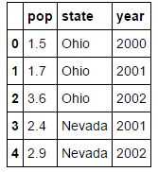
Pandas Data Structure – Data Frame
Tabular, spread sheet like data structure containing ordered collection of columns
Dataframe has both row and column index
>>data={'state':['Ohio','Ohio','Ohio','Nevada','Nevada'],
'year':[2000,2001,2002,2001,2002],
'pop':[1.5,1.7,3.6,2.4,2.9]}
>> df=pd.DataFrame(df)

Slide 31
Data Analysis Example 1 – Simple Data Plot using Pandas and Matplotlib

Slide 32
Example1
Goal
Simple Line plot
Description
Data set will consist of names and heights of the person
( We will explore adding some fields to the dataset as well)
Concepts
Creating / Manipulating data frames
Plotting data

Slide 33
#Step 1: Imports
from pandas import DataFrame, read_csv
import matplotlib.pyplot as plt
import pandas as pd
%matplotlib inline
# Step 2: Data
names=['John','Bob','David', 'Mary']
heights=[5.6,5.7,5.8,5.7]
data = {'names':names, 'heights':heights}
df= DataFrame(data)
# Step 3 Plot
df.plot()
plt.show()

Slide 34
How to have names on x-axis?
>>df.index=df['names']
Adding column to the data frame
>> weights=[160,150,140,130]
>>df['weights']=weights
>>df.describe()
>> #Plotting scatter plot
>> plt.scatter (df['heights'],df['weights']
>> plt.show()

Slide 35
CSV I/O
>>frame.to_csv('heights.csv', index=False, header=False)
>>df=read_csv('heights.csv', header=None, names=['heights', 'names'])

Slide 36
Data Analysis
Finding the max value
>>df['heights'].max()
Which person has the max height
>>df[df['heights']==df ['heights'].max()]
Other functions
df.mean(), df.var(), df.mean() ……………….
Can also apply the methods on a particular column using indexing

Slide 37
Example2: Groupby Operations OR Aggregations
Let us suppose that we have more than one measurements for a person and we want to include average of those measurements
>>names=['Bob','John','David','Mary','Bob']
>>heights = [5.8,5.7,6,5.5,5.8]
>>data={'names':names, 'heights':heights}
>>frame = DataFrame(data)

Slide 38
Example 2: Groupby
>>df= frame.groupby(frame['names'])
>>df = df.mean()
>> df.plot()
>> plt.ylim(ymin=0)
>> plt.ylim(ymax=7)
>> plt.show()

Slide 39
Class Activity 5
Given the data
data={'state':['Ohio','Ohio','Ohio','Nevada','Nevada'],
'year':[2000,2001,2002,2001,2002],
'pop':[1.5,1.7,3.6,2.4,2.9]}
Make a plot showing State and year on X-axis and Population on y-axis
Make a bar plot showing the average population of Ohio and Nevada
Hint : Use groupby and mean

Slide 40
Statistics in Python
Imports
>>import scipy.stats as stats
>> import statsmodels.api as sm
>> import numpy as np
>> import matplotlib.pyplot as plt

Slide 41
Summary Statistics
>>stats.describe?
'''
Returns
Size of the Data, Range, Arithmetic Mean, Unbiased Variance, Biased Skewness, Biased Kurtosis
'''

Slide 42
T-Tests
>> x1 = np.random.randn(100, 1)
>> x2 = np.random.randn(100, 1)
>> tstat, pval = stats.ttest_ind(x1, x2)
>> print "T-statistic = %s; P-value = %s." % (tstat, pval)

Slide 43
Basic Regression
x = np.array(range(20))
y = 3 + 0.5 * x + 2 * np.random.randn(20)
#plot the data
plt.plot(x, y, 'bo')
plt.show()
results = sm.OLS(y, x).fit()
print results.summary()
slope= results.params[0]
plt.plot(x, y, 'bo')
plt.hold(True)
# Plot a line
y = slope * x
plt.plot(x, y, 'r-')
plt.show()
#imports
>>import scipy.stats as stats
>> import statsmodels.api as sm
>> import numpy as np
>> import matplotlib.pyplot as plt

Slide 44
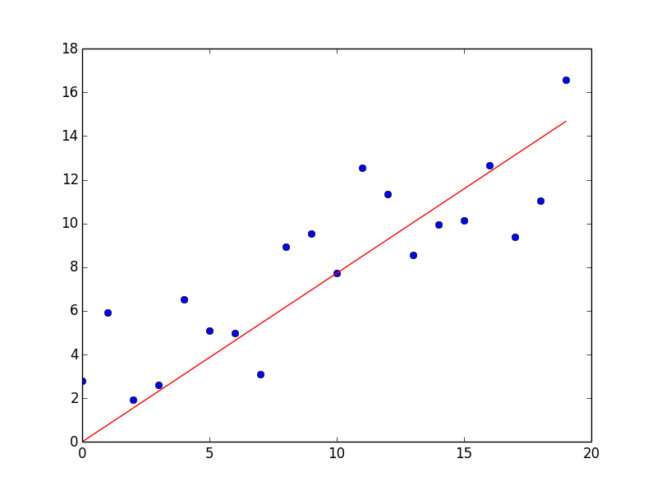

Slide 45
Road Ahead
Additional Tutorial Links will be posted on Canvas

Slide 46
The End

